Slide 1

Introduction to Database Concepts
Vasugi

Slide 2
Introducing the Database
Data Versus Information
Data constitute building blocks of information
Information produced by processing of data
Good, timely, relevant information key to decision making
Good decision making key to organizational survival

Slide 3
Database Management System
Database is shared, integrated computer structure housing:
End user data
Metadata
Database Management System (DBMS)
Manages Database structure
Controls access to data
Contains query language

Slide 4
Importance of Database
Makes data management more efficient and effective
Query language allows quick answers to ad hoc queries
Provides better access to more and better managed data
Promotes integrated view of organization’s operations
Reduces the probability of inconsistent data

Slide 5
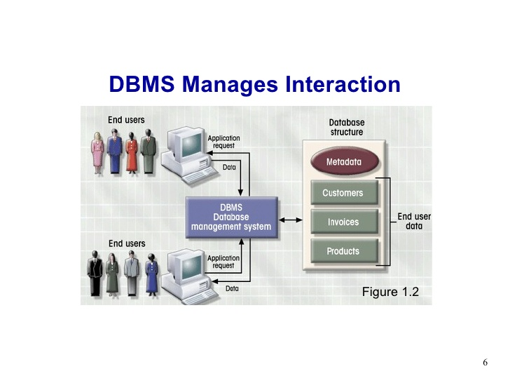

Slide 6
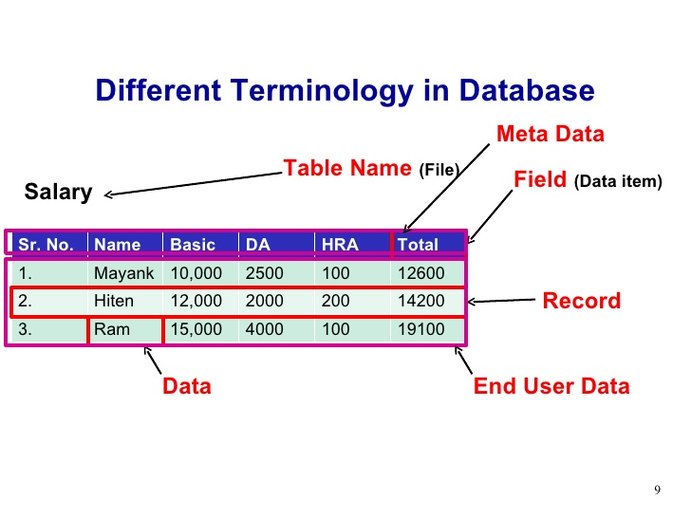

Slide 7
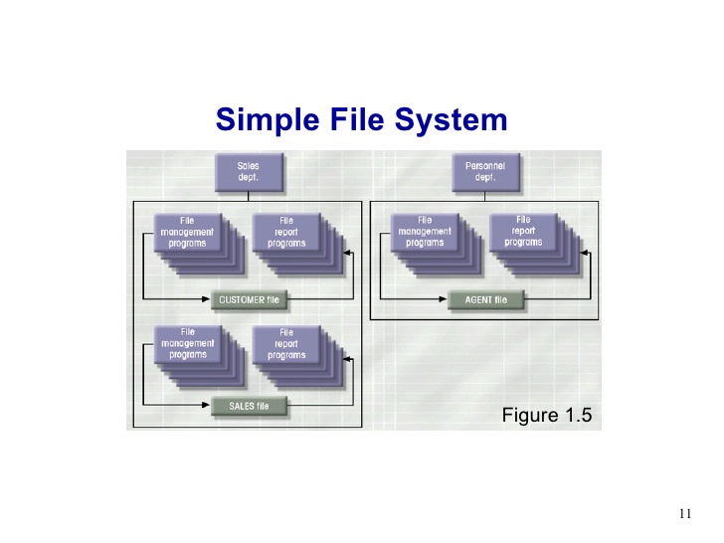

Slide 8
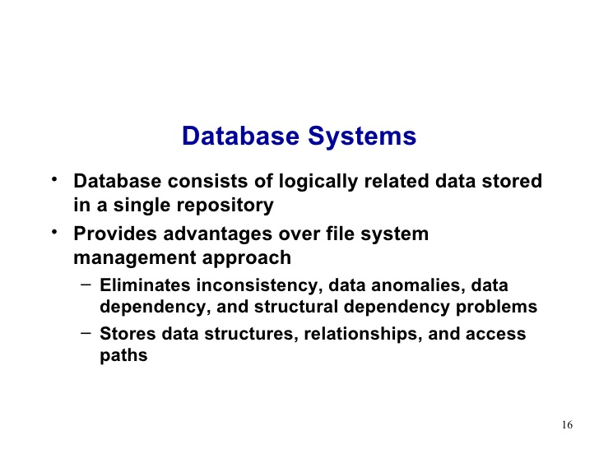

Slide 9
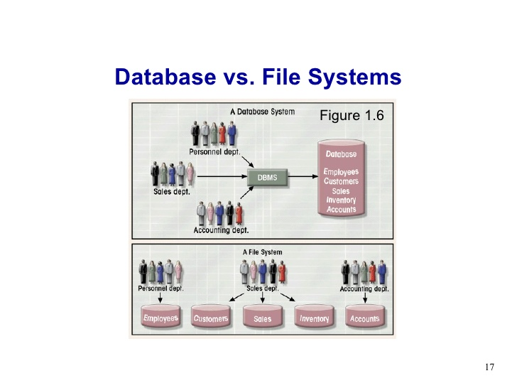

Slide 10
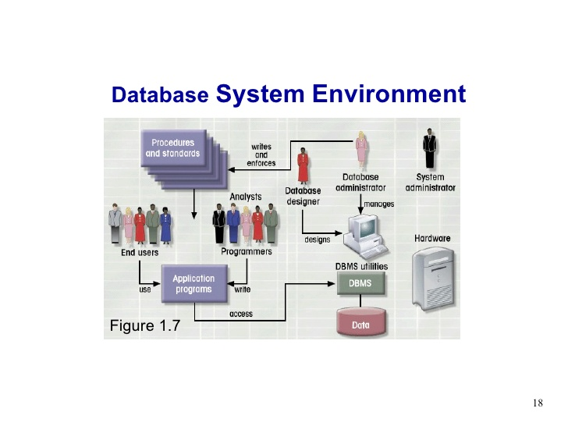

Slide 11
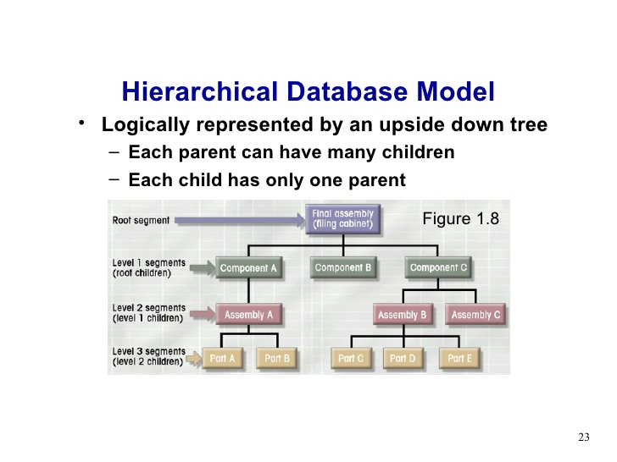

Slide 12
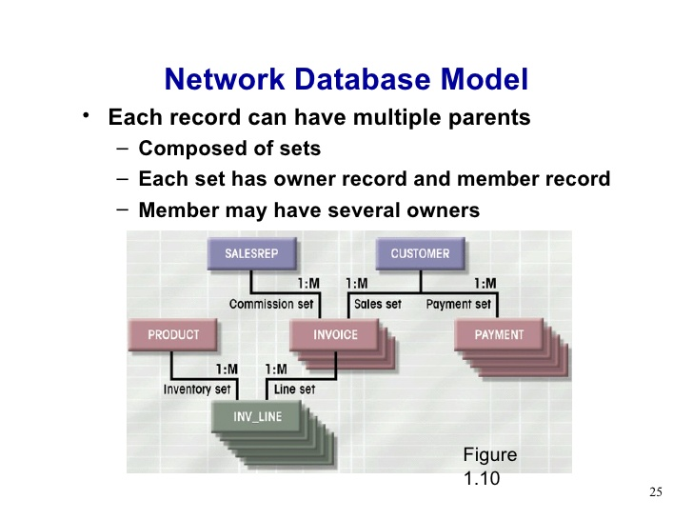

Slide 13
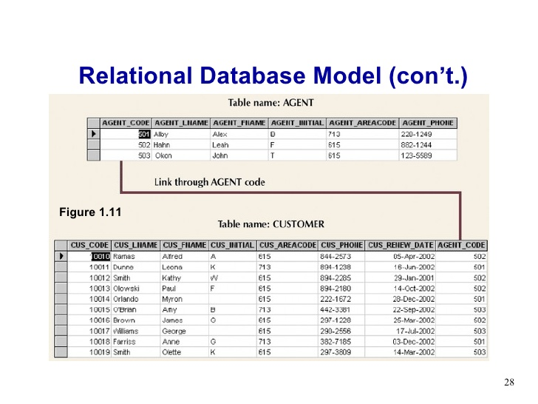

Slide 14
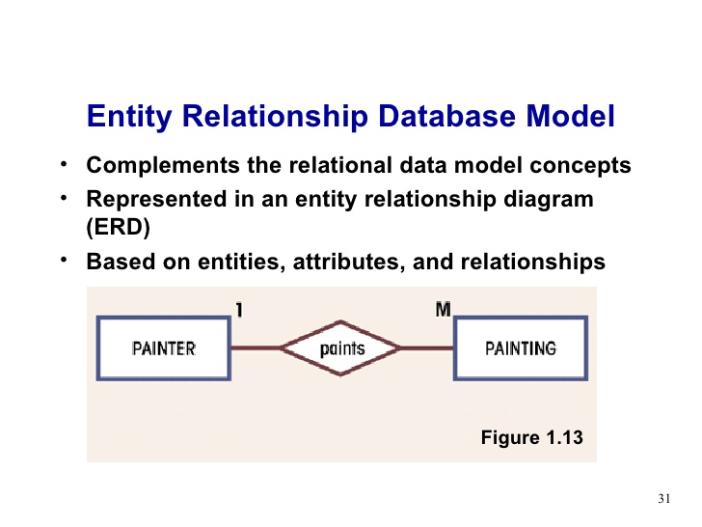

Slide 15
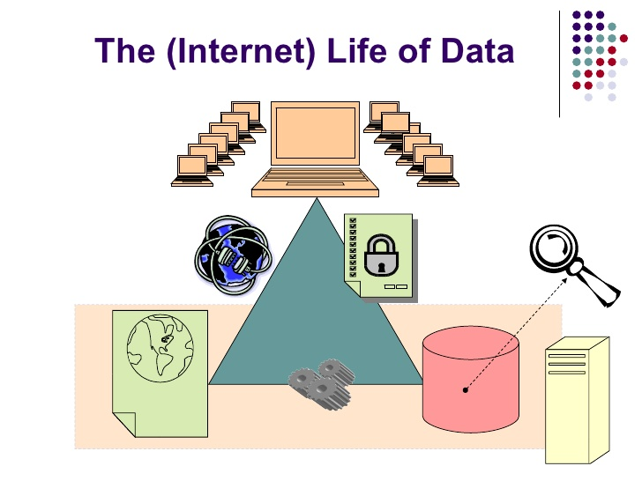

Slide 16
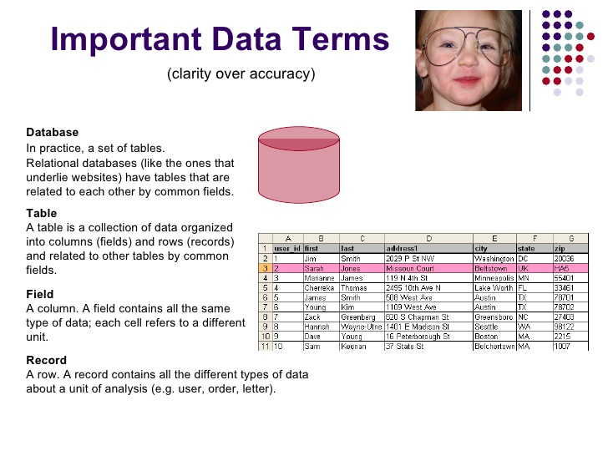

Slide 17
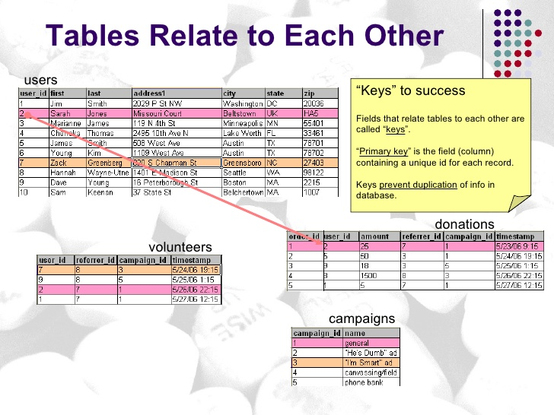

Slide 18
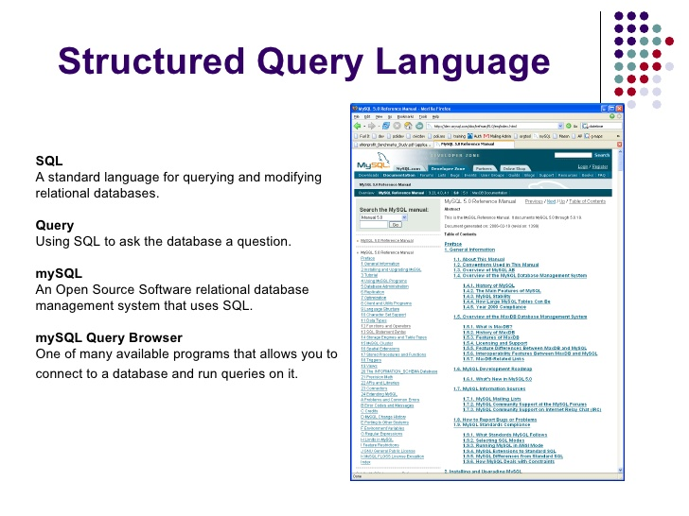

Slide 19
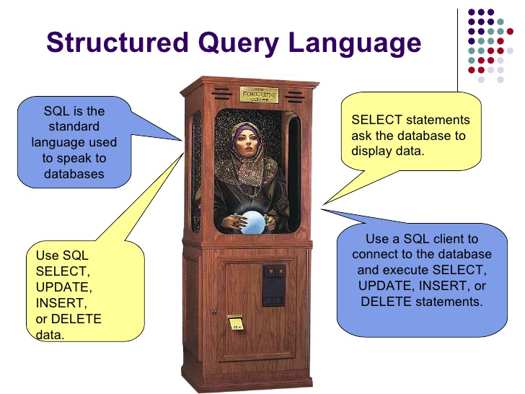

Slide 20
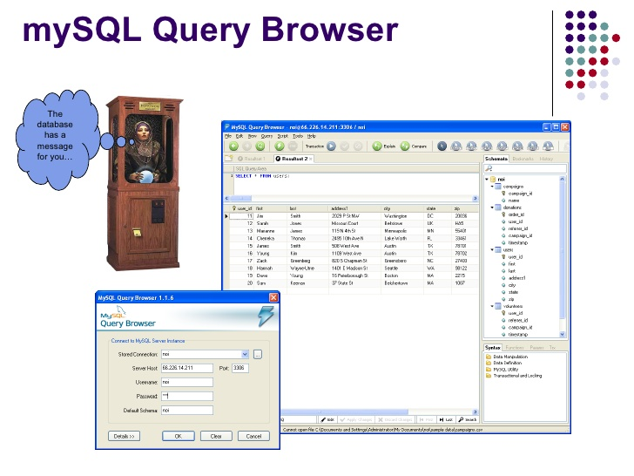

Slide 21
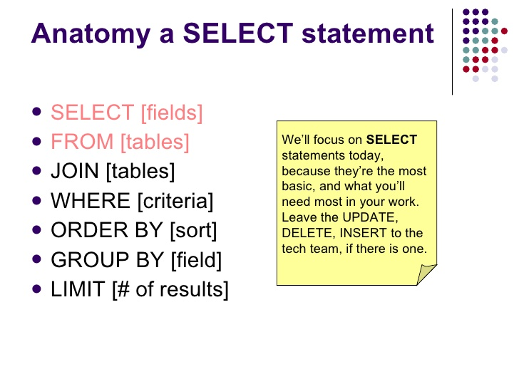

Slide 22
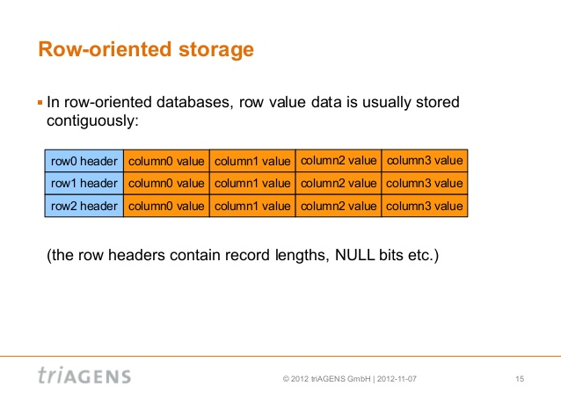

Slide 23
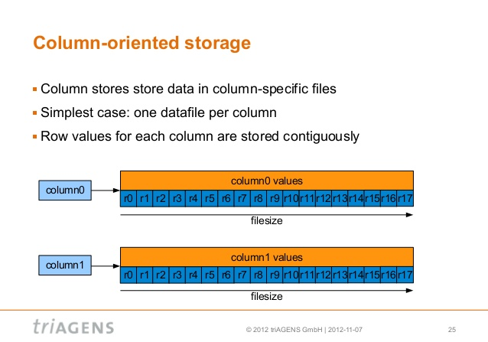

Slide 24
From Database to Big Data

Slide 25
Scalability of Distributed Systems
A good Distributed System is effective when there is a significant increase in number of resources and number of users.
Big Data is a HUGE increase in resources.
Adding more and/or faster processing units works well ONLY if the components have been designed well!
Components should NOT need to be changed when scale of a system increases.

Slide 26
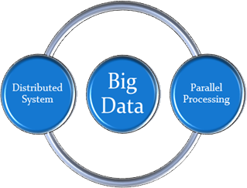
Distributed Systems and Big Data
A Distributed System needs to be well designed in order to handle Big Data and also adapt as the need arises.
No alternatives, however:
Big Data is, in fact, too big for a single computer!

Slide 27
Parallel Processing

Slide 28
What is Parallel Processing?
Parallel processing is the ability to carry out multiple operations or tasks simultaneously.
http://en.wikipedia.org/wiki/Parallel_processing

Slide 29
About Parallel Processing of Big Data
Parallel processing involves taking a large chunk of data, dividing it into several smaller tasks, and then working on each of those smaller tasks simultaneously.
The goal of this divide-and-conquer approach is to complete the larger task in less time than it would have taken to do it in one large chunk.

Slide 30
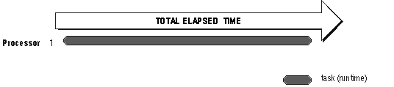
About Parallel Processing of Big Data
Sequential Processing

Slide 31
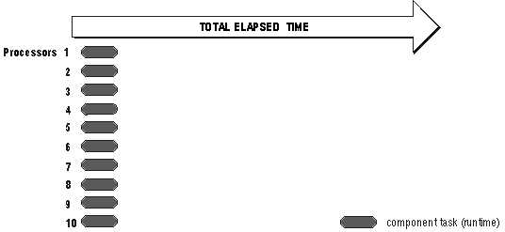
About Parallel Processing of Big Data
Parallel Processing

Slide 32
Why Parallel Processing?
Because of Big Data
5 Exabytes (1018) of new information from print, film, optical storage in 2002.
Billions of web pages, social media with millions of users, millions of blogs
How do friends affect my reviews, purchases, choice of friends
Facebook: 955M active users & more than 100 petabytes of photos and videos

Slide 33
Why Parallel Processing?
Because of Big Data
Business World: Billions of transactions, real-time detection
Retail stores: What products are people buying together? What promotions will be most effective?
Marketing: Which ads should be placed for which keyword query?

Slide 34

Why Parallel Processing?
Personalization of marketing purposes

Slide 35
Why Parallel Processing?
Because of hardware trends
Moore’s Law: number of transistors that can be placed inexpensively on an integrated circuit doubles about every 2 years

Slide 36
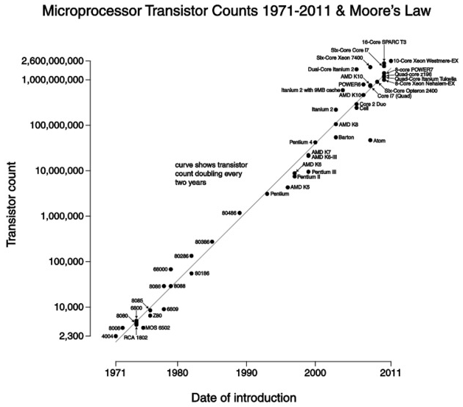
Why Parallel Processing?

Slide 37

Why Parallel Processing?
“Party” ended around 2004’
There are physical limitations on this trend of constant improvement.
Clock speed remains below 4 GHz
This speed is limited unless
moving towards the speed of
light.

Slide 38
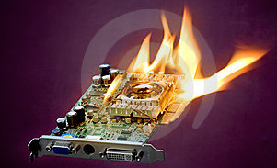
Why Parallel Processing?
But to achieve the speed of light, optical communication methods would have to be used within processors.
Heat issues prevent higher clock speeds, the transistors create electromagnetic interference for one another.

Slide 39
Characteristics of a Big Data Parallel System
Computer hardware that is designed to work with multiple processors and that provides a means of communication between those processors
An operating system that is capable of managing multiple processors
Application software that is capable of breaking large tasks into multiple smaller tasks that can be performed in parallel (Hadoop).

Slide 40
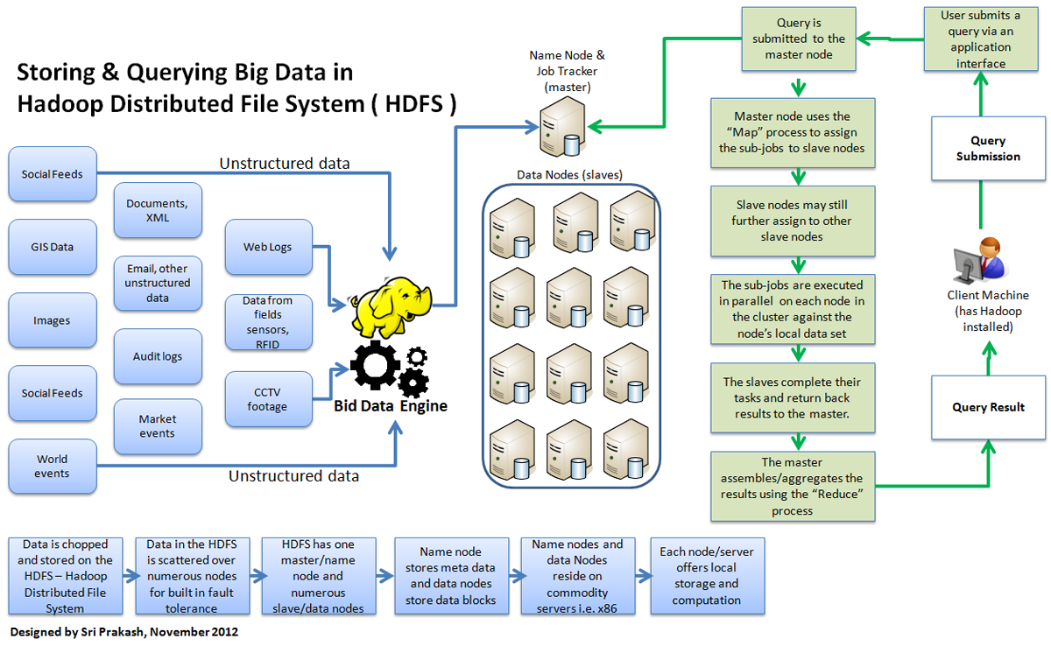
Hadoop with Parallel Processing

Slide 41
Advantage of Parallel Processing
Higher throughput
More fault tolerance
Cheaper
Better performance

Slide 42
Parallel Processing
High-speed data conversion:
converts event-data from random access format to distributed parallel analyzing format immediately.
Flexible resource allocation:
connects different type data processing components and scalable distributed Key-Value Store.
Load-adaptive resource optimization:
conducts hardware resource allocation and load balancing.

Slide 43
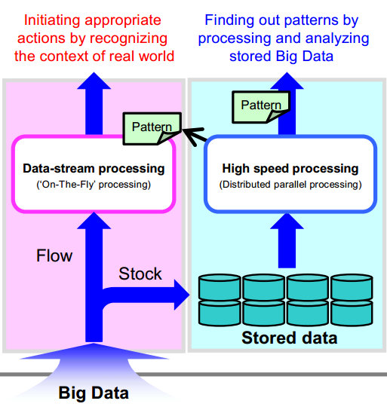
Parallel Processing

Slide 44
Challenges of a Big Data Parallel Processing
Synchronization between parts of a program executed by different processors is an overhead of parallelism that needs to be managed and kept at a minimum.
Administering a parallel computing environment is more complicated than administering a serial environment.
Application is capable of decomposing large tasks into multiple smaller, parallelizable tasks.

Slide 45
Open Source Solutions

Slide 46
Oracle Berkeley DB
open source, embeddable databases
most widely used open source database in the world
Notes:
open source, embeddable databases that allows developers to incorporate within their applications a fast, scalable, transactional database engine with industrial grade reliability and availability. It is the most widely used open source database in the world with deployments estimated at more than 200 million.
most widely used open source database in the world with deployments estimated at more than 200 million.

Slide 47
MySQL
Open source database software for web, cloud and mobile applications
Community engagement as well as the user base.
Notes:
MySQL is the world's most popular open source database software for web, cloud and mobile applications, with more than 100 million copies of its software downloaded and distributed throughout its history. Oracle continues to drive MySQL innovation with a focus on growing both the community engagement as well as the user base.

Slide 48
OrientDB
2nd Generation Distributed Graph Database with the flexibility of Documents in one product with an Open Source commercial friendly license (Apache 2 license).
Incredibly fast: it can store 220,000 records per second on common hardware.
Supports schema-less, schema-full and schema-mixed modes.
Strong security profiling system based
Notes:
2nd Generation Distributed Graph Database with the flexibility of Documents in one product with an Open Source commercial friendly license (Apache 2 license). First generation Graph Databases lack the features that Big Data demands: multi-master replication, sharding and more flexibility for modern complex use cases.
OrientDB is incredibly fast: it can store 220,000 records per second on common hardware. Even for a Document based database, the relationships are managed as in Graph Databases with direct connections among records. You can traverse parts of or entire trees and graphs of records in a few milliseconds. Supports schema-less, schema-full and schema-mixed modes. Has a strong security profiling system based on user and roles and supports SQL amongst the query languages. Thanks to the SQL layer, it's straightforward to use for those skilled in the relational database world.

Slide 49
RexDB
is a platform for creating Configurable Data Repositories (CDRs).
integrate complex structured data, for example, to support on-demand data repurposing.
includes a powerful set of functions for data acquisition;
valuable where traditional data warehousing approaches are too rigid and expensive.
Notes:
RexDB is a platform for creating Configurable Data Repositories (CDRs). Unlike typical data warehouses and data marts, CDRs can be configured by implementation analysts, usually with little-to-no help from software engineers, and with no help from database administrators.
Because it focuses on flexibility through model-driven configuration, RexDB should be considered anytime an organization needs to continuously integrate complex structured data, for example, to support on-demand data repurposing. RexDB includes a powerful set of functions for data acquisition; data centralization, organization, and curation; data use, repurposing, and dissemination; as well as a functions (such as configurable workflow screens) that support operational process management.
RexDB is valuable where traditional data warehousing approaches are too rigid and expensive. This occurs, for example, where the data are highly variable and complex, or where the metadata changes quickly

Slide 50
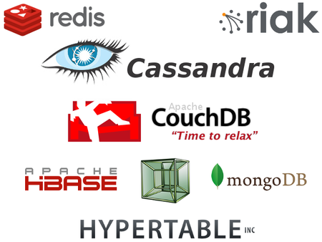
Open Source NoSQL Databases

Slide 51
Apache Cassandra
Is a database providing
scalability,
high availability and fault-tolerance on hardware,
virtual systems or cloud infrastructure.
Notes:
pache Cassandra is a database providing scalability, high availability and fault-tolerance on hardware, virtual systems or cloud infrastructure. With column indexing, log-structured updates, denormalized and materialized views and built-in caching, many large-scale organizations have chosen to use Cassandra (including Constant Contact, CERN, Comcast, eBay, GitHub, GoDaddy, Hulu, Instagram, Intuit, Netflix, Reddit, The Weather Channel, and many others). Features include automatic replication to multiple nodes for fault-tolerance, avoiding single points of failure by keeping cluster nodes identical, synchronous or asynchronous replication during updates, and read/write throughput supported without downtime or interruption. Third party contract support services for Apache Cassandra are also available.

Slide 52
Apache Cassandra
Automatic replication to multiple nodes
fault-tolerance, avoiding single points of failure
cluster nodes identical during updates, and read/write throughput supported without downtime or interruption.
Third party contract support services for Apache Cassandra are also available.
Notes:
Features include automatic replication to multiple nodes for fault-tolerance, avoiding single points of failure by keeping cluster nodes identical, synchronous or asynchronous replication during updates, and read/write throughput supported without downtime or interruption. Third party contract support services for Apache Cassandra are also available. Features include automatic replication to multiple nodes for fault-tolerance, avoiding single points of failure by keeping cluster nodes identical, synchronous or asynchronous replication during updates, and read/write throughput supported without downtime or interruption. Third party contract support services for Apache Cassandra are also available.

Slide 53
CouchDB
for web application database needs,
lacks a pre-defined data structure, or schema.
is stored in JSON
supports web and mobile apps and can serve web apps
can aggregrate, join and report on database documents
fully distributed and peer-based
Notes:
Specifically written for web application database needs, CouchDB lacks a pre-defined data structure, or schema. CouchDB data is stored in JSON documents that consist of name fields that can be strings, numbers, dates or ordered lists and associative maps. CouchDB supports web and mobile apps and can serve web apps directly out of CouchDB. Using JavaScript for description, CouchDB can aggregrate, join and report on database documents without affecting the underlying structure of the documents. CouchDB is fully distributed and peer-based, with servers and offline-clients that can have independent replica copies of the same database. Replication activities include conflict management, incremental and bi-directional replication, filtered replication and Master/Slave and Master/Master replication. CouchDB is written in the Erlang programming language which has built-in support for concurrency, distribution, fault tolerance, and the language and runtime are able to take advantage of newer hardware with multiple CPU cores.

Slide 54
Apache Hbase
is distributed, scalable, secure and provides high availability.
Modeled after Google's BigTable, HBase can handle massive data tables
Notes:
otable for running on top Hadoop Distributed File System (HDFS, Apache's Hadoop file system), Apache Hbase is distributed, scalable, secure and provides high availability. Modeled after Google's BigTable, HBase can handle massive data tables containing billions of rows, millions of columns, and utilizes storage, memory and CPU resources across multiple servers within a cluster so that the database scales horizontally. Other features include Kerberos security across tables and columns, automatic sharding, full consistency, and a scale-out architecture allowing for the addition of servers for increased capacity. HBase also features compression, in-memory operation and Bloom filters on a per-column basis. MapReduce jobs run in Hadoop and can use HBAse tables for input and output.

Slide 55
Hypertable
Modeled after Bigtable
has a flattened out table structure and employs key-prefix and block data compression.
is sorted by primary key.
features of Hypertable include
cell versioning (timestamps),
column qualifiers,
namespaces (like a directory hierarchy in a filesystem),
"realtime" scaling
Notes:
Modeled after Bigtable (the massively scalable database from Google), Hypertable has a flattened out table structure and employs key-prefix and block data compression. In comparison to a relational database, it has little resemblance, save that it represents data as tables of information in rows and columns. Row keys in Hypertable are UTF-8 strings and there is no support for data types, joins or transactions. Stored as massive tables of data, information in Hypertable is sorted by the row key, which is the sole and primary key. Other features of Hypertable include cell versioning (timestamps), column qualifiers, namespaces (like a directory hierarchy in a filesystem), and "realtime" scaling when additional servers are added to the RangeServer processes.

Slide 56
MongoDB
is written in C++ and is a NoSQL DB.
Features include
document-oriented storage (JSON-style documents,
dynamic schemas),
full index support (on any attribute),
replication and high availability (across LANs and WANs for scale),
auto-sharding (scale horizontally),
querying,
rapid in-place updates and map/reduce.
Notes:
The open source document database MongoDB is written in C++ and is a NoSQL DB. Features include document-oriented storage (JSON-style documents, dynamic schemas), full index support (on any attribute), replication and high availability (across LANs and WANs for scale), auto-sharding (scale horizontally), querying, rapid in-place updates and map/reduce. MongoDB also has flexible aggregation and data processing, GridFS, (store files of any size), MongoDB management service and professional support. One advantages of MongoDB is embedded documents and arrays, which reduce the need for expensive joins. Additionally, dynamic schema supports fluent polymorphism and documents correspond to native data types in many programming languages.

